Slide 1

App Modernization
Deep Dive Week

Slide 2

Deep Dive Week - Agenda
Day 1 | Day 2 | Day 3 | Day 4 | Day 5
Design and Build Web apps & APIs with Azure App Services | App Telemetry with Application Insights | Data Services for Modern Apps | Cloud Adoption Framework | .NET Modernization in a Day Workshop
Expose your APIs with Azure API Management | Secure your Apps with Azure Key Vault | AI: Cognitive Services | App Migration and Tools
Expose your APIs with Azure API Management | DevOps: Infrastructure as Code

Slide 3
Deep Dive Week – Day 1
Day 1
Design and Build Web apps & APIs with Azure App Services | 10 Min Theory | 20 Min Practice | 10 Min Q&A
Expose your APIs with Azure API Management | 10 Min Theory | 20 Min Practice | 10 Min Q&A
Expose your APIs with Azure API Management | 10 Min Theory | 20 Min Practice | 10 Min Q&A
All in One Wrap Up | 30 Min Practice

Slide 4
Design and Build Web Apps & APIs with Azure App Services
Jaqueline Ramos
Cloud Solution Architect – Azure AppDev
www.linkedin.com/in/jaquecr
Paulo Sérgio Baima
Cloud Solution Architect – Azure AppDev
www.linkedin.com/in/paulobaima

Slide 5
Balance of responsibility
Responsibility | On-Prem | IaaS | PaaS | SaaS
Applications
Data
Runtime
Middleware
O/S
Virtualization
Servers
Storage
Networking
Balance of control and responsibility depends on the category of the service
MOVE-IN READY
Use immediately with minimal configuration
SOME ASSEMBLY REQUIRED
Existing services are a starting point, with additional configuration for a custom fit
BUILD FROM THE GROUND UP
Building blocks, create your own solution or apps from scratch
Customer
Microsoft
Notes:
Objective:
Illustrate the differences between IaaS, PaaS and SaaS in a more technical way
Key talking points:
The balance of control and responsibility for managing solutions depends on the category of the service.
The chart summarizes the balance of responsibility for both Microsoft and the customer.
Conclusion:
If your primary business function isn’t running compute infrastructure, you can get more from your scarce developer time by using an application platform that removes complexity and maintenance responsibility. There might be some trade-off considerations around flexibility, but overall, you can get more done faster and with lower total cost of ownership building on platform as a service (PaaS).

Slide 6


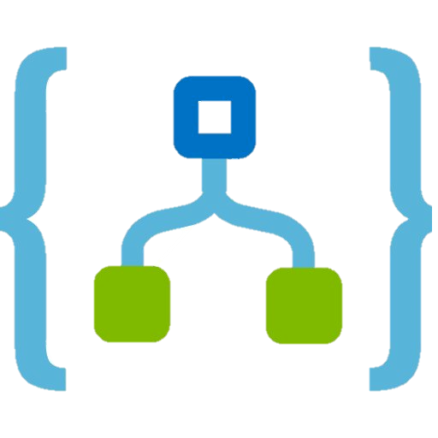
Deep Dive Week – Day 1
Azure
VMs / Scale Sets
Azure
Kubernetes Service
Azure
App Service
Azure
Functions
Azure
Logic Apps
Control Productivity
Notes:
Introducing App Service and Azure Functions from a team that obsesses about time to market and developer experience! Also, Functions as a PaaS growth

Slide 7
Azure App Service
Quickly build, deploy and scale powerful cloud applications without worrying about infrastructure
High productivity
.NET, Node, Java, Docker, PHP, Ruby, Python
Staging & deployment
Testing in production
Predictable Costs
Fully managed
Auto scale & load balancing
High availability w/ auto patching
Reduced operations costs
Backup & recovery
Enterprise grade
Global data center footprint
Hybrid support
AAD integration
Secure & compliance

Slide 8



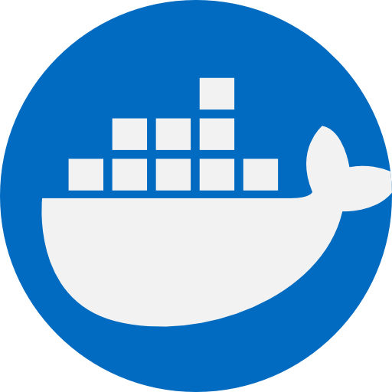
Deep Dive Week – Day 1
Code
Container
Code
Container
IIS Based
Docker Windows
Based
Docker Linux
Based (Pre Configured)
Docker Linux
Based (Custom)

Slide 9


Deep Dive Week – Day 1
App Service Plan
Is the backend resource of the App Services
All WebApps run on top of an AppService Plan
All WebApps on a AppService plan share the resources
All WebApps on a AppService plan scale together

Slide 10
Deep Dive Week – Day 1
App Service on Linux is not supported on Shared pricing tier.
You can't mix Windows and Linux apps in the same App Service plan.
Within the same resource group, you can't mix Windows and Linux apps in the same region.
https://docs.microsoft.com/en-us/azure/app-service/overview#app-service-on-linux

Slide 11
Deep Dive Week – Day 1
Azure App Service SKUs
Free
Shared
Basic
Standard
Premium
Isolated
https://azure.microsoft.com/en-us/pricing/details/app-service/

Slide 12
Demo Creating an AppService with Azure Portal

Slide 13
Demo Creating an AppService with Azure CLI

Slide 14
Deep Dive Week – Day 1
Azure App Service Deploying Methods
IDEs
(Visual Studio/VSCode/Others)
FTP
REST API
Azure CLI
DevOps Toolings
(Azure DevOps, GitHub, Jenkins,etc.)
Advanced Console Zip Deploy
https://azure.microsoft.com/en-us/pricing/details/app-service/

Slide 15
Demo Deploying a .NET Application with Visual Studio

Slide 16
Demo Deploying a NodeJS Application with Azure CLI

Slide 17
Demo Deploying a Container Application with Azure DevOps

Slide 18

Deep Dive Week – Day 1

Slide 19
Demo App Services Metrics and Alerts

Slide 20
Deep Dive Week – Day 1
Azure App Service Scaling
Scale Up/Down
Scale Out/In
Change the Machine Size
Manual
Has Downtime
Change the Number of Instances
Manual or Automatic
No Downtime

Slide 21
Demo App Services Scaling

Slide 22
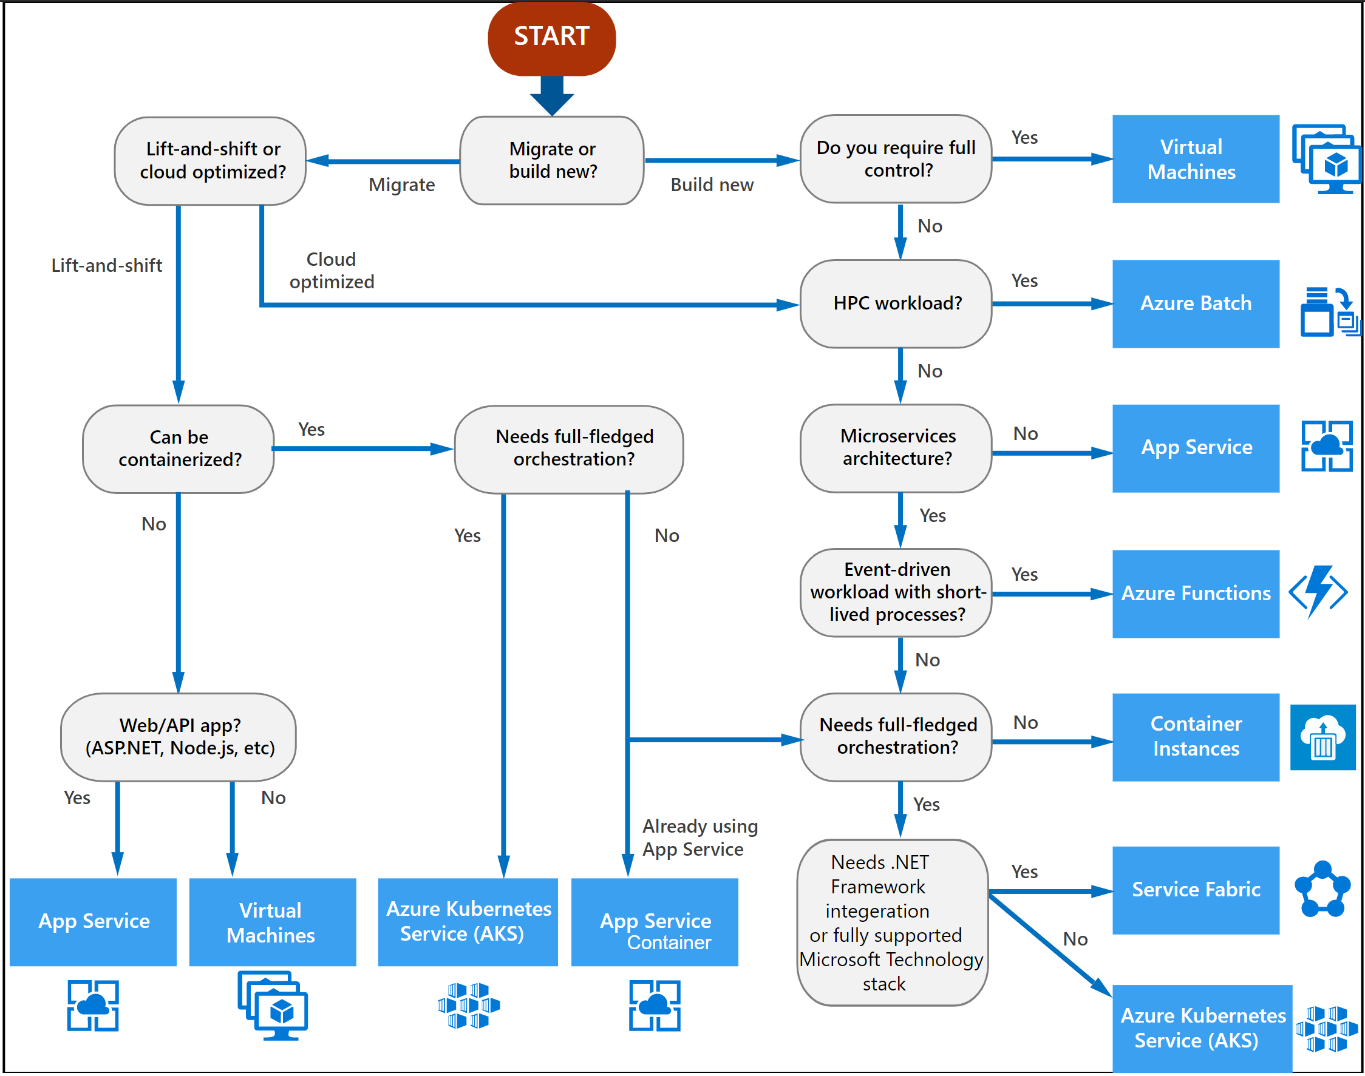
Deep Dive Week – Day 1
How to choose your Compute Service
Management Cost
Control
Productivity
Perfomance
Operational Cost
https://docs.microsoft.com/en-us/azure/architecture/guide/technology-choices/compute-decision-tree

Slide 23
QnA Questions?

Slide 24

10 minute break

Slide 25
Expose your APIs with Azure API Management
Jaqueline Ramos
Cloud Solution Architect – Azure AppDev
www.linkedin.com/in/jaquecr
Paulo Sérgio Baima
Cloud Solution Architect – Azure AppDev
www.linkedin.com/in/paulobaima

Slide 26


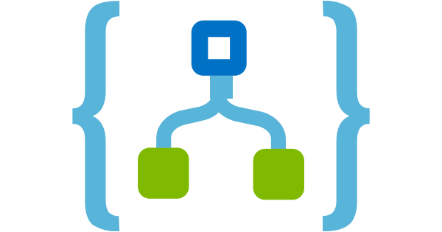

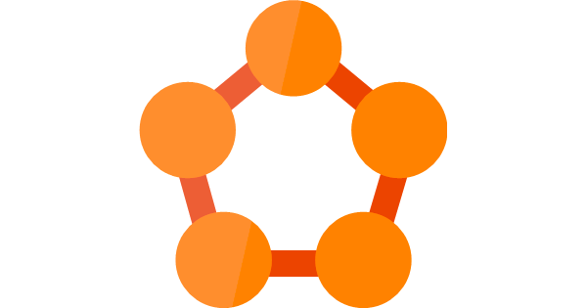


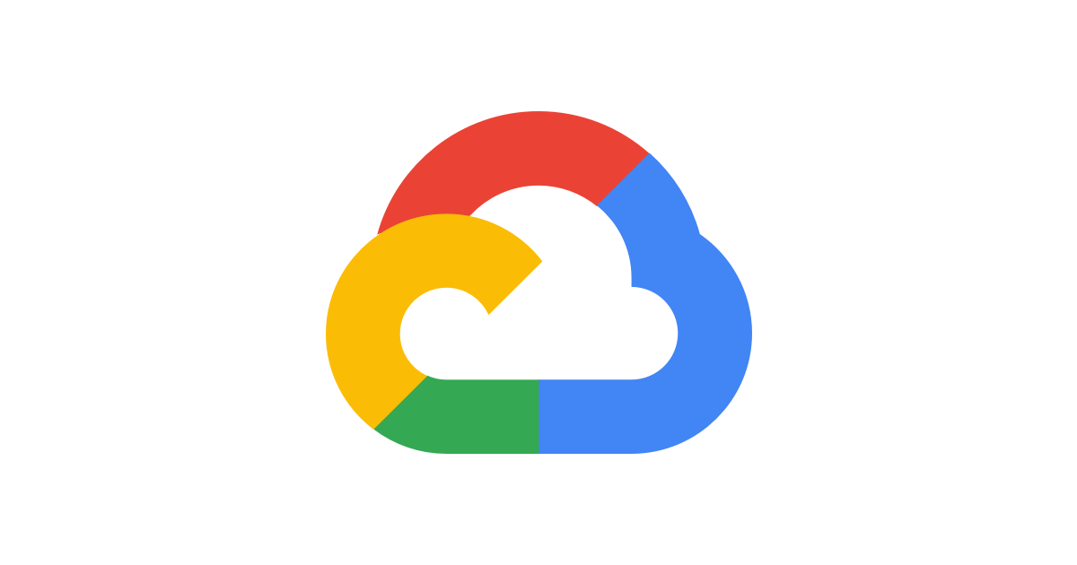

Deep Dive Week – Day 1
Today we have multiple options to host APIs
How can we manage all of this and things such as:
Authentication
User Management
Subscriptions
Documentation
Versioning
And more…

Slide 27

Azure API Management
API consumers
AZURE API MANAGEMENT
Abstraction
decouple
modernize
optimize
...
Middleware
secure
protect
cache
...
Monitoring
usage
health
monetization
...
Developer
discover
document
on-board
...
Custom APIs on Azure
Azure APIs
On-prem APIs
3rd party APIs

Slide 28



AZURE API
MANAGEMENT
APP DEVELOPERS
Developer Portal
DIRECT OR
VPN
BACKEND
APIs
APPS
API Gateway
Hosted anywhere.
Developed using any technology.
API PUBLISHERS
Azure portal

Slide 29
Demo Creating an API Management Through Azure Portal

Slide 30
Demo Creating an API with Azure API Management

Slide 31
Products
Deep Dive Week – Day 1
How you offer APIs to consumers
Default products: Starter & Unlimited
A Product has:
A name, display name & description
Legal Terms
One or more APIs
Has access control
Determines which users can view / subscribe
Only “published” products are visible to non-admin users

Slide 32
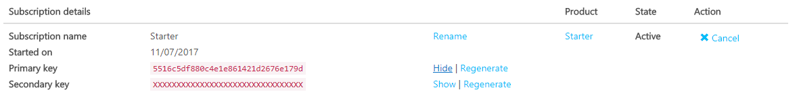
Deep Dive Week – Day 1
Products
Created when:
User signs up for a product – Might require approval from admin
Admin creates a subscription on behalf of user
Can be cancelled by user or administrator
Has primary/secondary keys used for authentication on API calls

Slide 33
Deep Dive Week – Day 1
Subscribing to a Product
Subscription keys can be regenerated
Previous key is disabled
Used when key has been compromised
Names of header/parameter can be changed per-api
HTTP Header
Ocp-Apim-Subscription-Key
Query String
subscription-key

Slide 34
Demo Creating a Product with Azure API Management

Slide 35
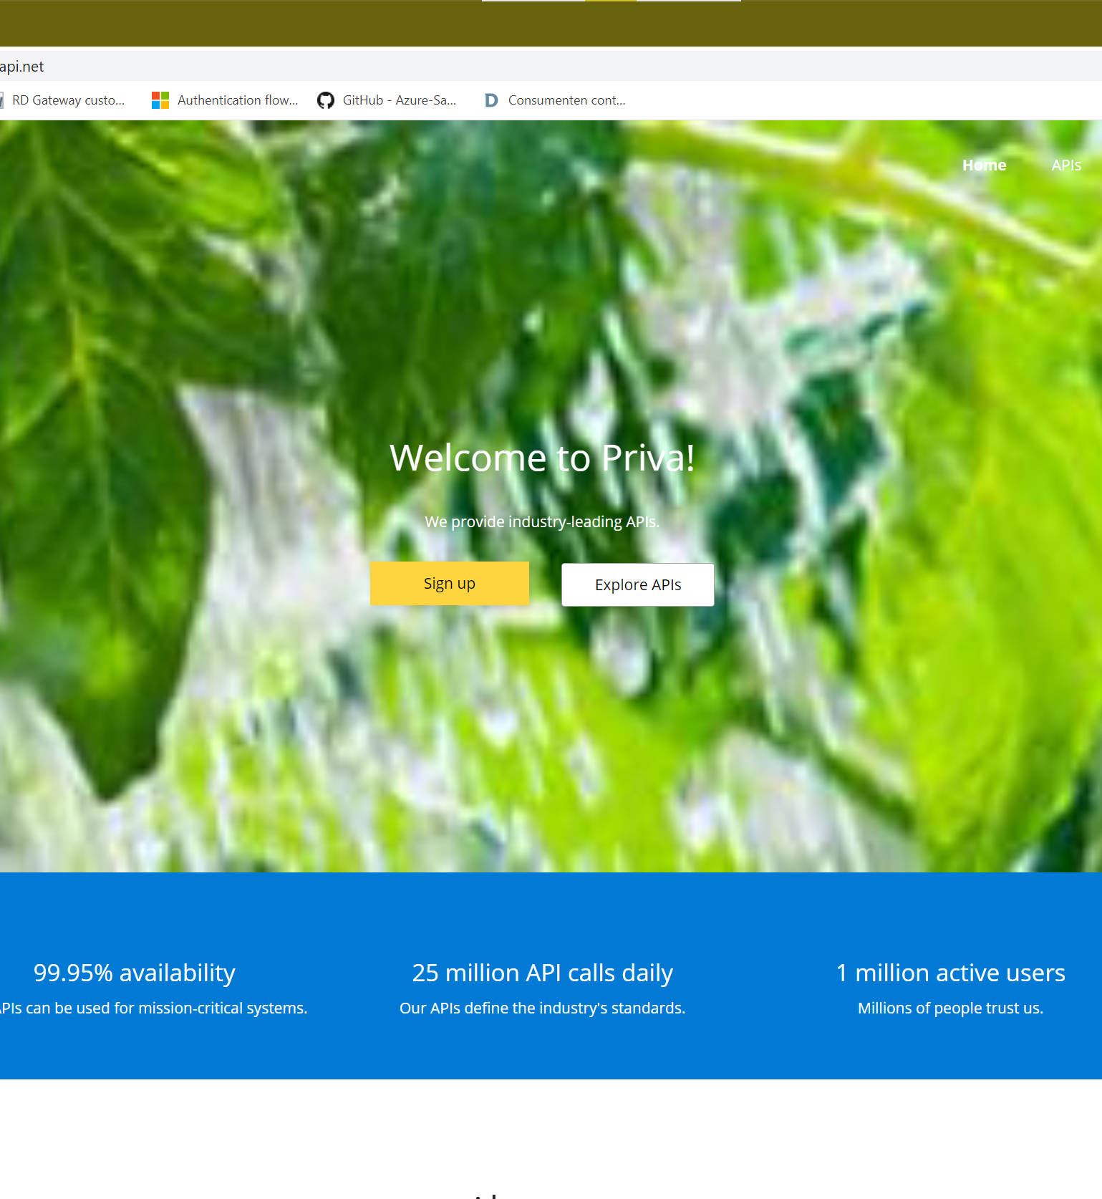
Developer Portal
Where consumers of APIs can:
Find available APIs
Read API Documentation
Test APIs
Create accounts and subscribe to products
Access usage analytics

Slide 36
Demo Subscribing to a product

Slide 37
Demo Customizing the Developer Portal

Slide 38
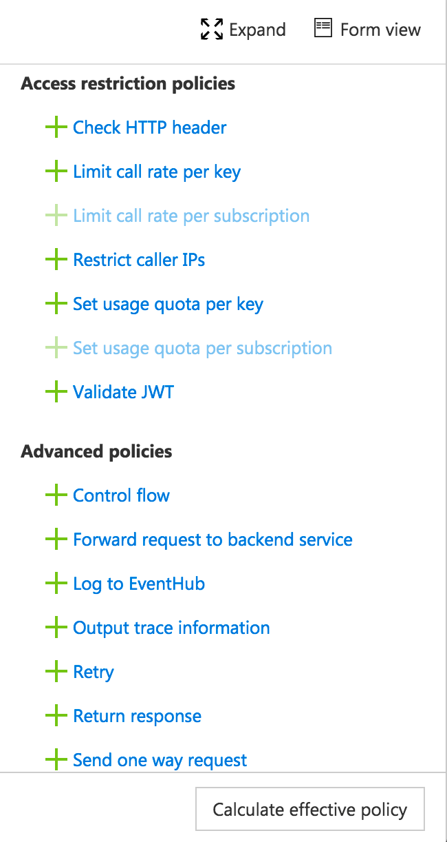
Policies
Deep Dive Week – Day 1
Encapsulate common API management functions
Access control, Protection, Transformation, Caching, …
Chained together into a pipeline
Mutate request context or change API behavior
Set in the inbound and outbound directions
Can be triggered on error
Applied at a variety of scopes

Slide 39
Demo Creating API Management Policies

Slide 40
QnA Questions?

Slide 41
10 minute break

Slide 42
Building Serverless Apps with Azure Functions
Jaqueline Ramos
Cloud Solution Architect – Azure AppDev
www.linkedin.com/in/jaquecr
Paulo Sérgio Baima
Cloud Solution Architect – Azure AppDev
www.linkedin.com/in/paulobaima

Slide 43
What is Serverless?
$
Abstraction of servers
Event-driven/ instant scale
Micro-billing

Slide 44
Functions as a Service Concept
Single responsibility
Functions are single-purposed, reusable pieces of code that process an input and return a result
Short lived
Functions don’t stick around when finished executing, freeing up resources for further executions
Stateless
Functions don’t hold any persistent state and don’t rely on the state of any other processes
Event driven & scalable
Functions respond to predefined events, and are instantly replicated as many times as needed

Slide 45

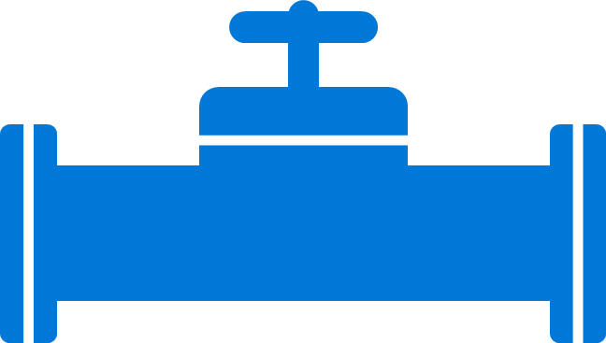
Azure Functions Boost Developer Efficiency
Use triggers to define how functions are invoked
Avoid hardcoding with preconfigured JSON files
Build serverless APIs using HTTP triggers
Connect to data with input and output bindings
Bind to Azure solutions and third-party services
Use HTTP bindings in tandem with HTTP triggers
Triggers
Bindings
Define one API surface for multiple function apps
Create endpoints as reverse proxies to other APIs
Condition proxies to use variables
Debug C# and JavaScript functions locally
Use debugging tools in Azure portal, VS, and VS Code
Proxies
Local debugging
Save time with built-in DevOps
Deploy functions using App Service for CI
Leverage Microsoft, partner services for CD
Integrate with Azure Application Insights
Get near real-time details about function apps
See metrics around failures, executions, etc.
CI/CD
Monitoring
Notes:
Additional information
Triggers and bindings – https://docs.microsoft.com/en-us/azure/azure-functions/functions-triggers-bindings
Monitoring—https://azure.microsoft.com/en-us/services/application-insights/
Local debugging—https://docs.microsoft.com/en-us/azure/azure-functions/functions-run-local#run-functions-locally
CI/CD—https://docs.microsoft.com/en-us/azure/azure-functions/functions-continuous-deployment
Run locally—https://docs.microsoft.com/en-us/azure/azure-functions/functions-run-local
Proxies—https://docs.microsoft.com/en-us/azure/azure-functions/functions-proxies

Slide 46

Azure Functions Increase Flexibility
Write code in C#, JavaScript, F#, and Java
Continuous investment in new, experimental languages
Write stateful functions in a serverless environment
Simplify complex, stateful coordination problems
Add the extension to enable advanced scenarios
Multiple languages
Durable Functions
Choose from six consumption plans to run Functions
Run your first million function executions for free
Simplify coding for new users with native Azure portal
Select from popular editors, like VS, VS Code, CLI
Hosting options
Dev options
Notes:
Additional information
Triggers and bindings – https://docs.microsoft.com/en-us/azure/azure-functions/functions-triggers-bindings
Monitoring—https://azure.microsoft.com/en-us/services/application-insights/
Local debugging—https://docs.microsoft.com/en-us/azure/azure-functions/functions-run-local#run-functions-locally
CI/CD—https://docs.microsoft.com/en-us/azure/azure-functions/functions-continuous-deployment
Run locally—https://docs.microsoft.com/en-us/azure/azure-functions/functions-run-local
Proxies—https://docs.microsoft.com/en-us/azure/azure-functions/functions-proxies

Slide 47





Azure Functions Language Support

Slide 48






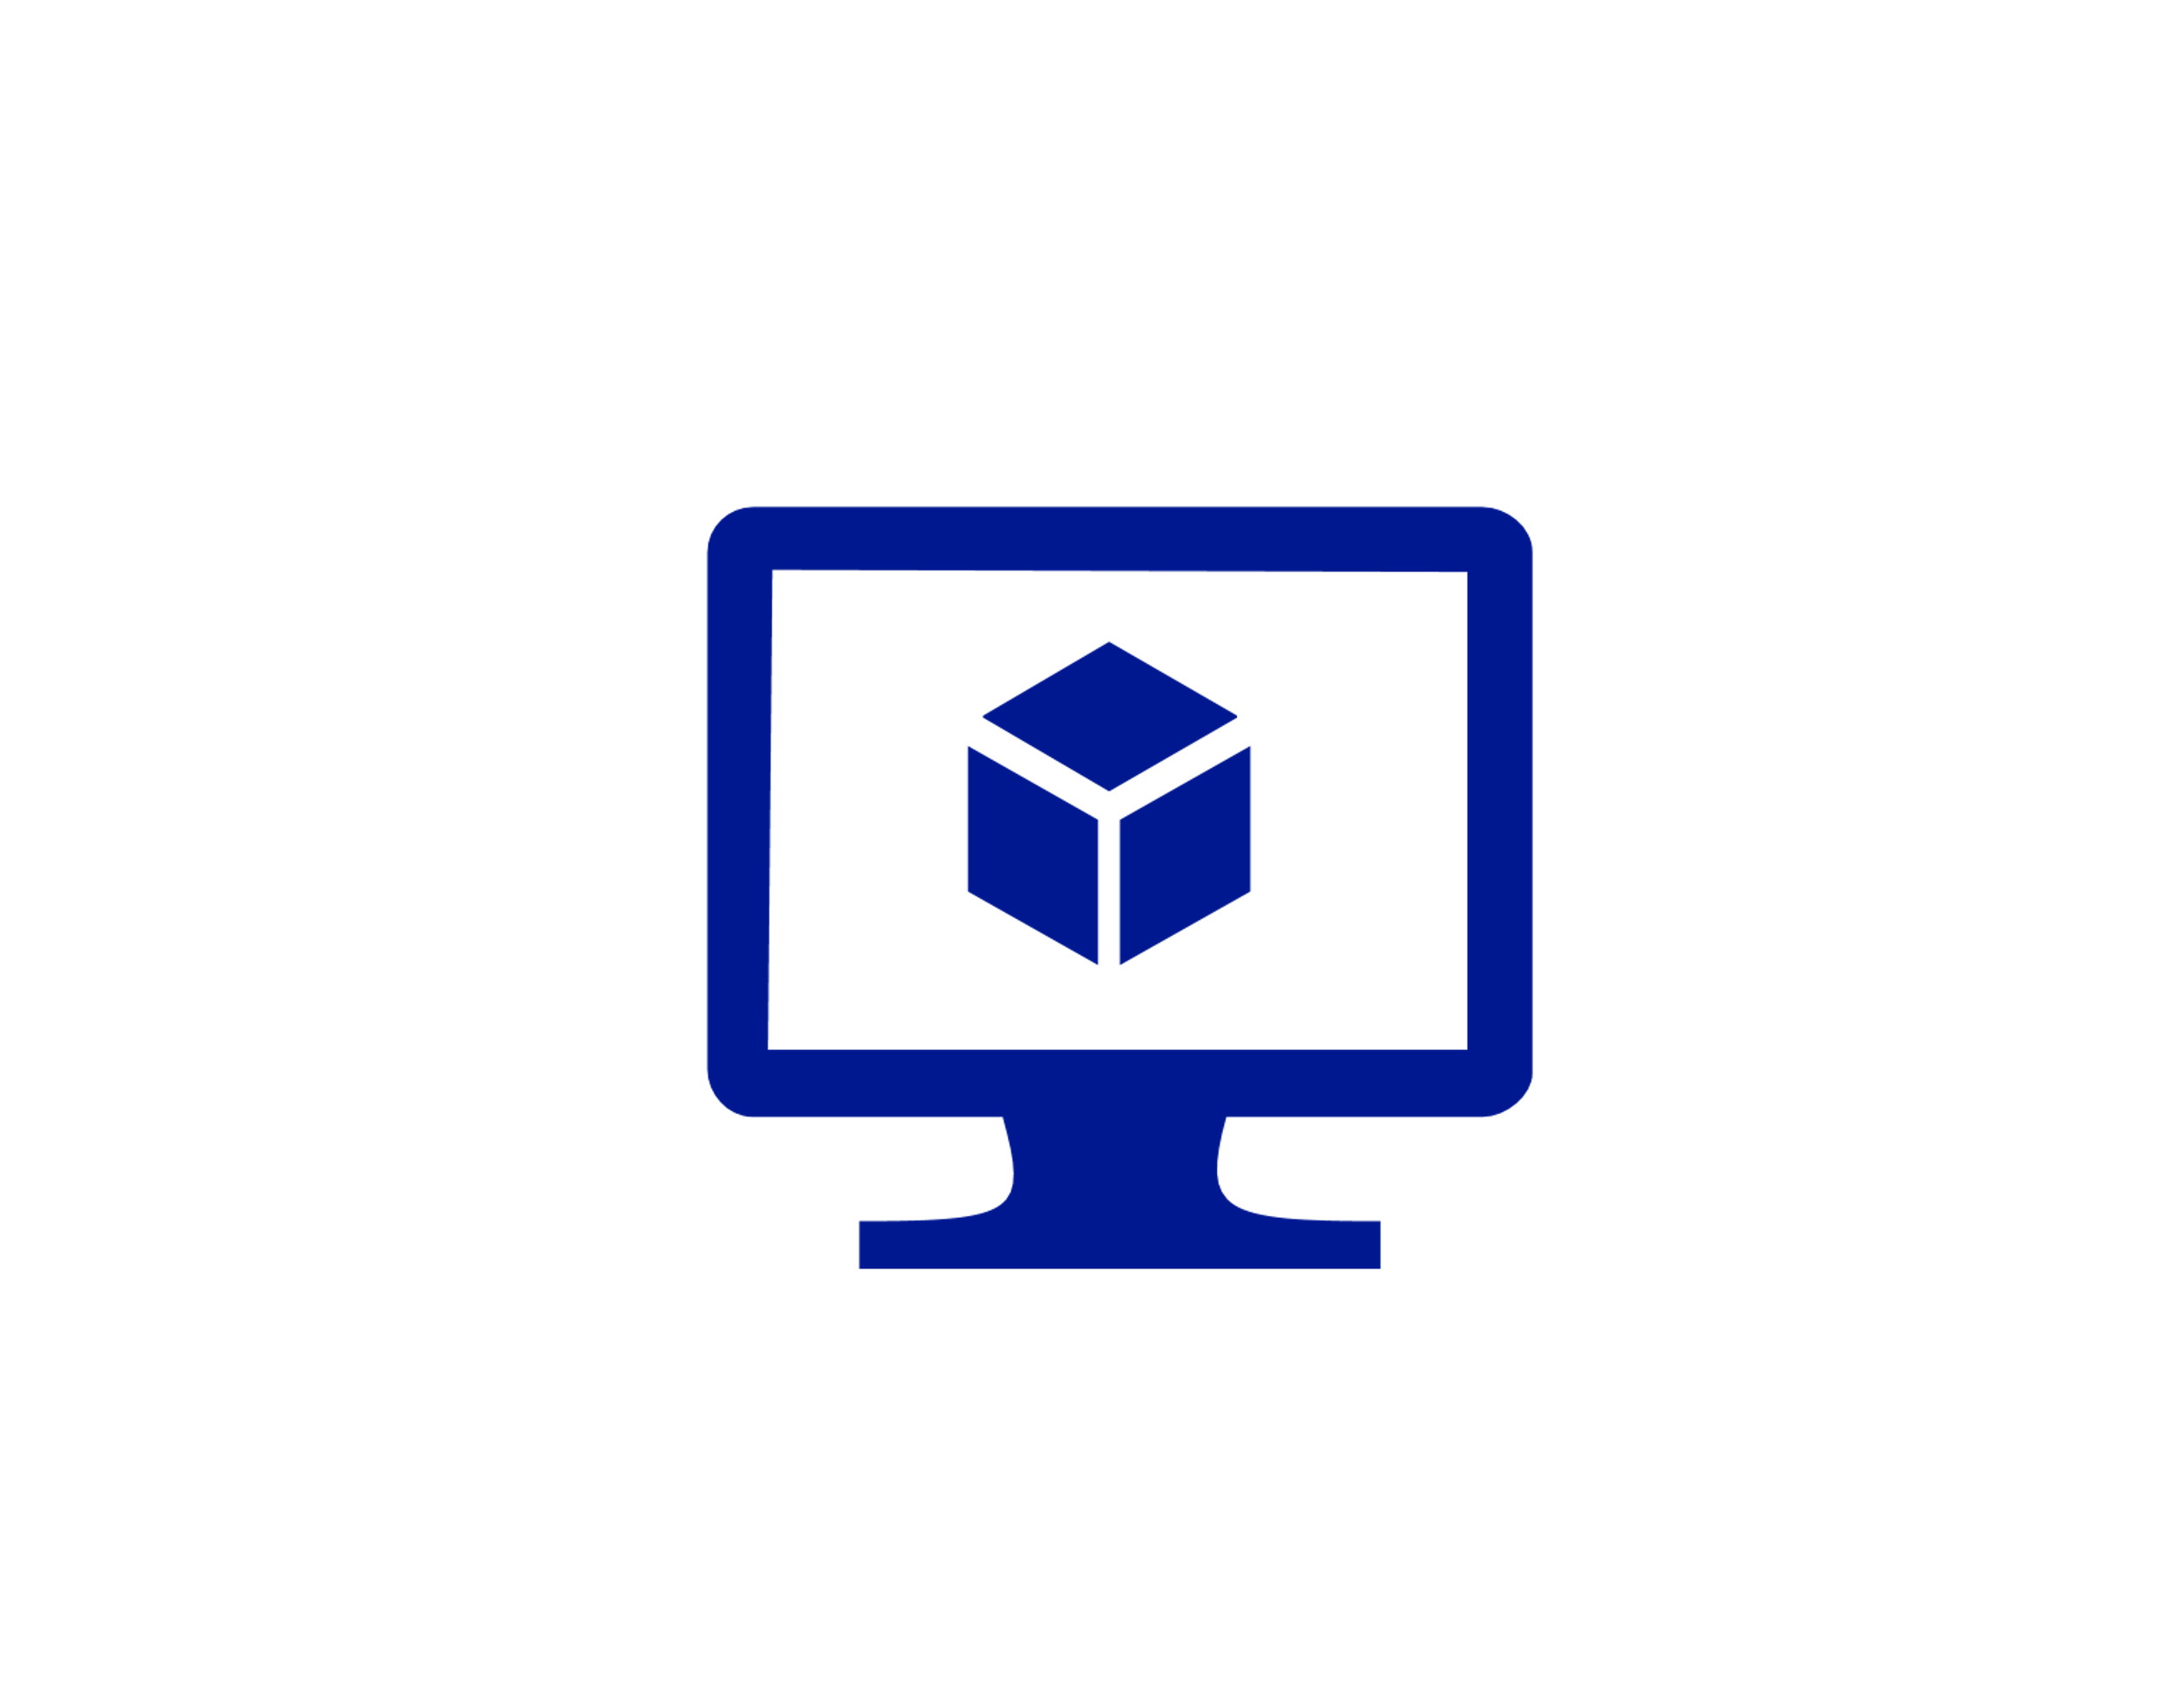

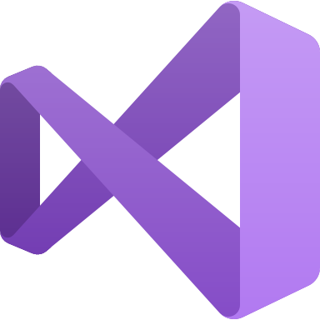

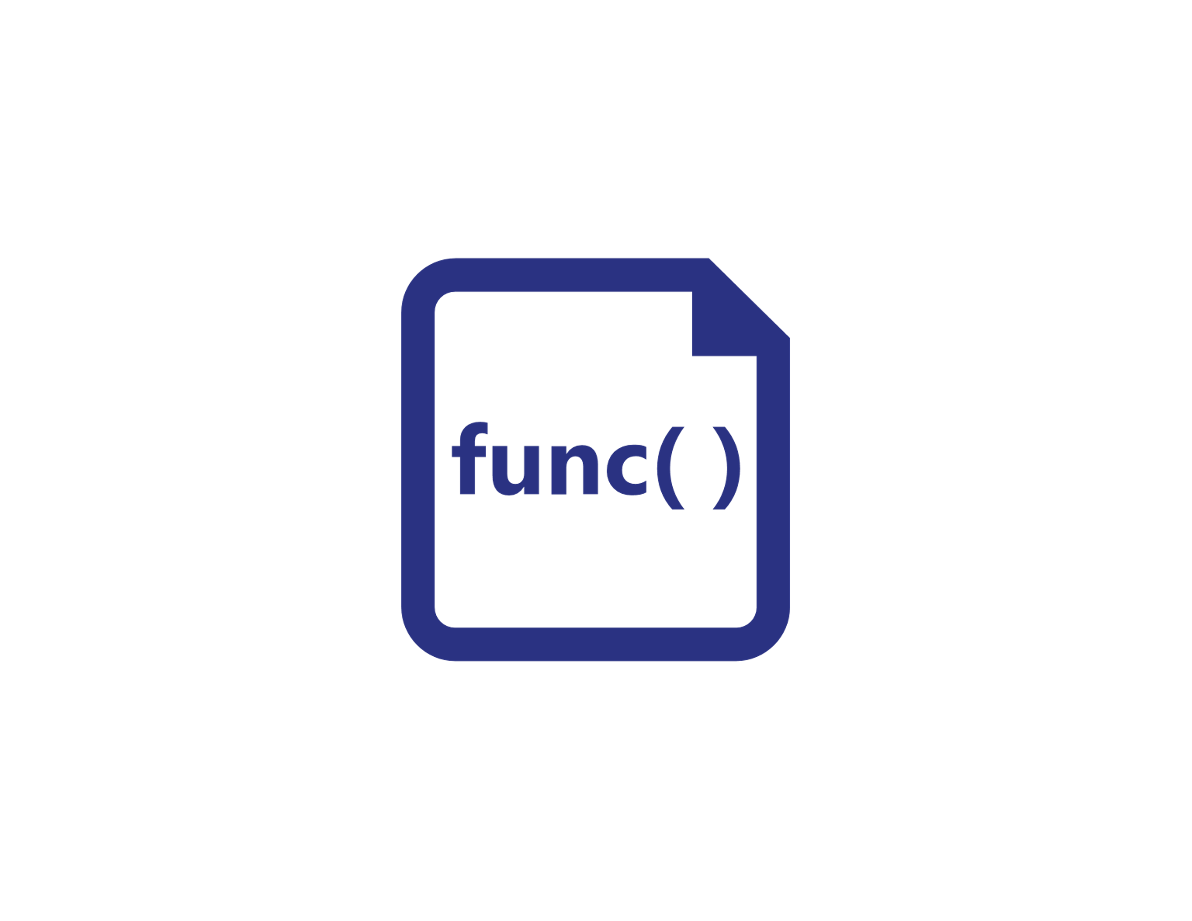




Azure Functions Hosting Options
Azure Functions host runtime
Azure Functions Core Tools
Azure Functions base Docker image
Azure Functions .NET Docker image
Azure Functions Node Docker image
●●●
Development
Hosting
Local dev machine
Azure Functions
service
Azure Functions
service
Azure Functions service
IoT devices
Additional Azure hosts
Non-Azure hosts / on-premises
Non-Azure hosts / on-premises
Platform
+
●●●
●●●
●●●
Core Tools + favorite editor
Consumption plan
Premium plan
App Service plan
Azure IoT Edge
AKS, Service Fabric, …
K8s, raw VMs, & more
App Service on Azure Stack
Application delivery
Code or container
Code
Code or container
Code or container
Container
Container
Container
Code
Operating system
Windows, macOS, or Linux
Windows or Linux
Windows or Linux
Windows or Linux
Linux
Linux
Linux
Windows

Slide 49
Demo Creating an Azure Function in the Portal

Slide 50

Azure Functions Triggers & Bindings
Blob Storage
Cosmos DB
Event Hub
HTTP
Queues
Service Bus
Timer
Webhook
TRIGGERS are what cause a function to run. A trigger defines how a function is invoked and a function must have exactly one trigger. Triggers have associated data, which is often provided as the payload of the function.
BINDING to a function is a way of declaratively connecting another resource to the function; bindings may be connected as input bindings, output bindings, or both. Data from bindings is provided to the function as parameters..

Slide 51
Demo Creating an Azure Function in Visual Studio

Slide 52
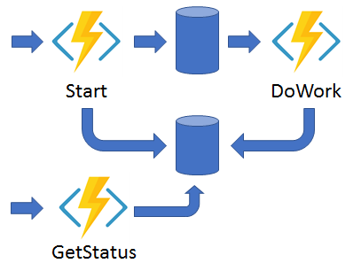
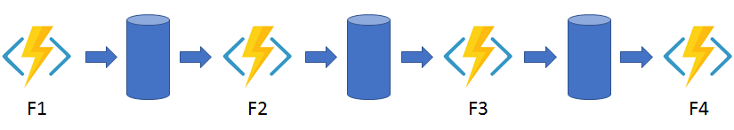
Introducing Durable Functions
Durable Functions: an extension of Azure Functions that lets you write stateful functions in a serverless compute environment.
The extension lets you define stateful workflows by writing orchestrator functions and stateful entities by writing entity functions using the Azure Functions programming model.
Behind the scenes, the extension manages state, checkpoints, and restarts for you, allowing you to focus on your business logic.

Slide 53
Demo Using Durable Functions

Slide 54
Demo Creating an Azure Function in Visual Studio

Slide 55
Demo Creating an Azure Function in VSCode

Slide 56
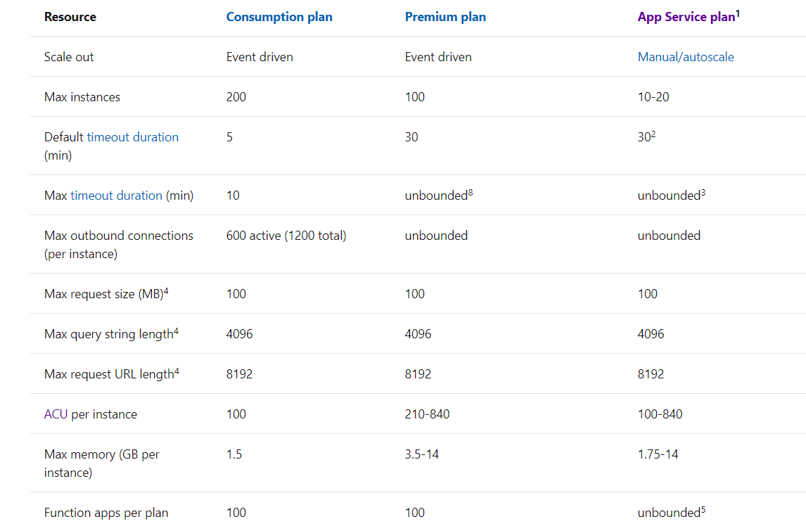
Azure Functions Service Limits

Slide 57
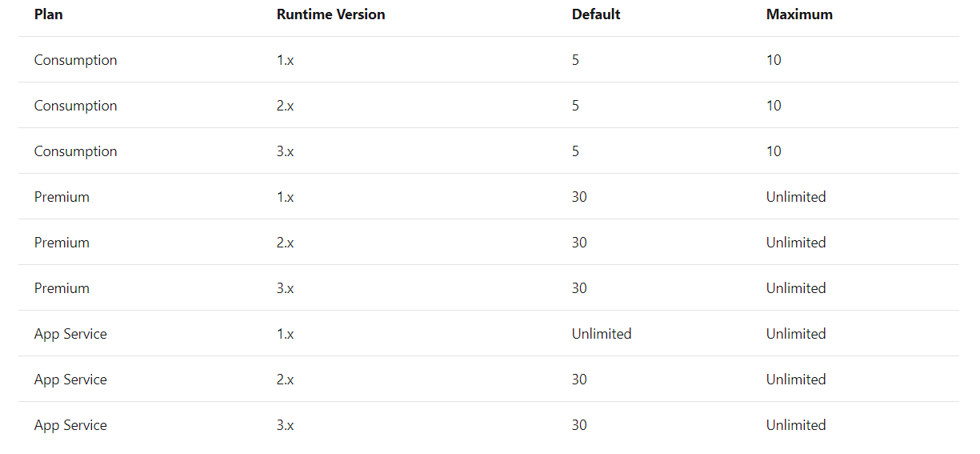
Azure Functions Duration Limits

Slide 58




Web application backends
Retail
Online orders are picked up from a queue, processed and the resulting data is stored in a database
Request made in a web app
Request queued in Service Bus
A function processes the request…
..sends output to Cosmos DB
Notes:
Building backends for web applications. An example could be a web app adding incoming orders to a queue and then Functions automatically picking up those orders to process and adding the output to a Cosmos DB.

Slide 59




Mobile application backends
Colleagues use mobile banking to reimburse each other for lunch: the person who paid for lunch requests payment through his mobile app, triggering a notification on his colleagues’ phones.
Scenario Example
Financial Services
Colleagues use mobile banking to reimburse each other for lunch: the person who paid for lunch requests payment through his mobile app, triggering a notification on his colleagues’ phones.
HTTP API call from a mobile app
Call processed by a function
Output data stored in Cosmos DB
Data transfer triggers second function…
…which sends notifications using Notifications Hub
Notes:
Building backends for mobile applications. A mobile app makes an API call to a Function, which does some processing and stores the data in Cosmos DB. This in turn again triggers another functioin which calls Notification Hub to send notifications out to multiple mobile devices.

Slide 60



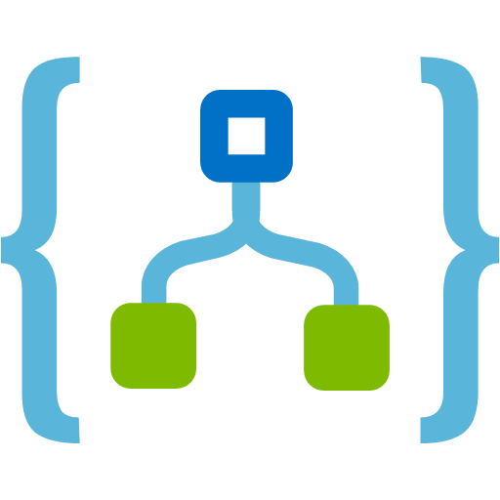


IoT-connected backends
A manufacturing company uses IoT to monitor its machines. Functions detects anomalous data and triggers a message to Service department when repair is required.
Connected IoT devices producing data
Scenario Example
Financial Services
Colleagues use mobile banking to reimburse each other for lunch: the person who paid for lunch requests payment through his mobile app, triggering a notification on his colleagues’ phones.
Data sent to IoT Hub
Data with special condition routed to a function
A function processes message...
…and calls Logic Apps
..which invokes Zendesk…
…to request device repair
Notes:
IoT is an important workload for serverless because of inherently spiky workloads associated with IoT. Processing huge amount of incoming data and doing some processing on that data in real time is a common serverless scenario

Slide 61


Conversational bot processing
Customer asks for available vacation accommodations on her smartphone. A serverless bot deciphers the request and returns vacation options.
?
?
Scenario Example
?
Financial Services
Colleagues use mobile banking to reimburse each other for lunch: the person who paid for lunch requests payment through his mobile app, triggering a notification on his colleagues’ phones.
User request through conversational interface
Bot running in a function deciphers request using language understanding
Another function processes the request
…and sends response to original requester
Notes:
Building backend logic for bots is a common serverless scenario especially due to short-lived processing and undeterministic traffic.

Slide 62

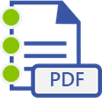





Real-time file processing
Patient records are securely uploaded as PDF files. That data is then decomposed, processed using OCR detection, and added to a database for easy queries.
Scenario Example
Financial Services
Colleagues use mobile banking to reimburse each other for lunch: the person who paid for lunch requests payment through his mobile app, triggering a notification on his colleagues’ phones.
PDF file added to Blob Storage
A function decomposes PDF file…
…and sends it to Cognitive Services for OCR detection
Structured data from file sent to SQL DB
Notes:
Data transofrmation in real-time for use between different applications is a common scenario.

Slide 63


Real-time stream processing
Huge amounts of telemetry data is collected from a massive cloud app. That data is processed in near real-time and stored in a DB for use in an analytics dashboard.
App or device producing data
Scenario Example
Financial Services
Colleagues use mobile banking to reimburse each other for lunch: the person who paid for lunch requests payment through his mobile app, triggering a notification on his colleagues’ phones.
Event Hubs ingests telemetry data
A function processes the data…
…and sends it to Cosmos DB
Data used for dashboard visualizations
Notes:
Processing streaming data for Big Data scenarios

Slide 64


Automation of scheduled tasks
A customer database is analyzed for duplicate entries every 15 minutes, to avoid multiple communications being sent out to same customers.
Scenario Example
Financial Services
Colleagues use mobile banking to reimburse each other for lunch: the person who paid for lunch requests payment through his mobile app, triggering a notification on his colleagues’ phones.
A function cleans a database every 15 minutes…
…deduplicating entries based on business logic
Notes:
Automating tasks that need to happen at regular intervals can be easily achieved using Functions. Whether it is for infra ops scenarios or just application architecture maintenance, Functions are a good fit.

Slide 65




Extending SaaS Applications
A SaaS solution provides extensibility through webhooks, which can be implemented through Functions, to automate certain workflows
Scenario Example
Financial Services
Colleagues use mobile banking to reimburse each other for lunch: the person who paid for lunch requests payment through his mobile app, triggering a notification on his colleagues’ phones.
Issue created in GitHub…
…which triggers a webhook call
…which is processed by a function…
…by posting the issue details to Slack
Notes:
Azure Functions provides a very natural way of responding to webhook requests which makes it an excellent choice for extending any SaaS applications providing webhook extensibility.

Slide 66
QnA Questions?

Slide 67
Day 1 – Wrap up
All in One Demo
Jaqueline Ramos
Cloud Solution Architect – Azure AppDev
www.linkedin.com/in/jaquecr
Paulo Sérgio Baima
Cloud Solution Architect – Azure AppDev
www.linkedin.com/in/paulobaima

Slide 68
Contoso Image Analysis
Deep Dive Week – Day 1
Contoso is a company that provides image analysis for their customers through a set of APIs.
The users send their images to Contoso, which analyze the images for Metadata and Face Recognition

Slide 69




Contoso Architecture
Deep Dive Week – Day 1
Get
Analysis
Extract
Metadata
user
Analyze
Image
Extract
Faces

Slide 70
QnA Questions?

Slide 71
Thank you

